Slide 1
Book Management System
Draft Version 1.0
Karthikeyan

Slide 2
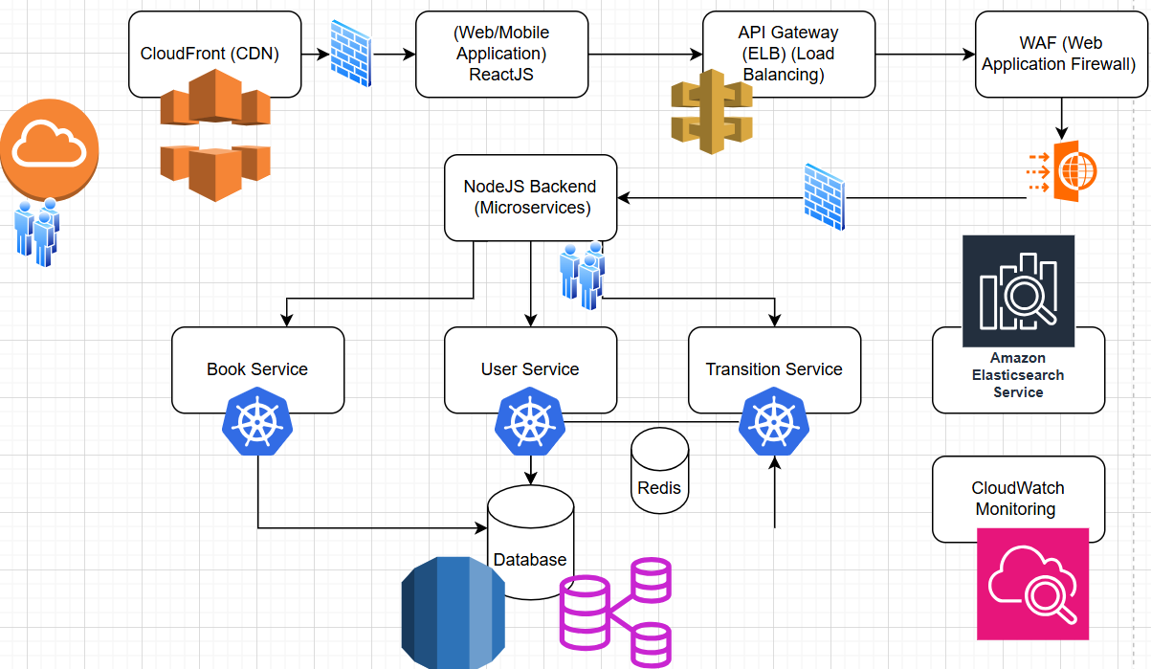
Architecture Diagram

Slide 3
Proposed Solutions..
1. Front-End (User Interface)
The front-end of the system will be developed using ReactJS, allowing for a dynamic and responsive user interface. React is a best choice for building modern web applications due to its speed, scalability, and ease of integration with backend services.
2. Backend (Node.js Microservices)
The backend will be built using Node.js with a microservices architecture. Microservices will help maintain modularity, making it easier to scale and manage specific functionalities as the system grows
3. Database & Data Management
The database layer will be managed using a combination of relational databases (SQL) and NoSQL databases.
A SQL database like PostgreSQL or MySQL will store structured data, including users, books, and transactions.
NoSQL DBs - MongoDB or DynamoDB (for cloud-native) could be used for semi-structured data such as logs, user activity, and perhaps some non-critical metadata. NoSQL allows greater flexibility and can scale horizontally.
4. Search Functionality
To support fast, full-text searches for books, an Elasticsearch instance will be integrated into the system.

Slide 4
Proposed Solutions..
5. Scalability and Cloud-Native Deployment
The system will be designed to run on cloud-native infrastructure using services like AWS, Google Cloud, or Microsoft Azure. The key principles will include scalability, high availability, and fault tolerance.
Containerization: The backend services will be containerized using Docker, ensuring that they are portable and can run in any environment (local, staging, or production).
Kubernetes will be used for container orchestration, enabling the system to scale horizontally based on demand and ensuring that the services remain highly available.
AWS Cloud Services:
Elastic Load Balancer (ELB): Manages incoming traffic and distributes it across multiple service instances.
CloudFront (CDN): Used to deliver static content such as images, book covers, and JavaScript files to users globally with low latency.
WAF (Web Application Firewall): Protects the system from common web exploits like SQL injection and cross-site scripting (XSS).
CloudWatch: Monitors the system's performance and generates logs and metrics that can be used for proactive monitoring and reporting.

Slide 5
Proposed Solutions…
6. Security & Compliance
Security will be a core aspect of the system, ensuring that user data is safe and protected. We will implement the following:
Authentication & Authorization:
Use OAuth 2.0 and JWT tokens for user authentication and secure access control across the system
Data Encryption:All sensitive user data will be encrypted both in transit (using HTTPS) and at rest (using database-level encryption).
Web Application Firewall (WAF):A WAF will be deployed to prevent unauthorized access and attacks like cross-site scripting (XSS), SQL injection, and other malicious attacks.
7. Reporting & Analytics
The Reporting Service will integrate with AWS CloudWatch and other analytics tools to provide detailed insights into user activity, transaction logs, and book status.
Real-Time Monitoring: Using CloudWatch, you can monitor system metrics, track errors, and identify bottlenecks in real-time.

Slide 6
Difference between client-side rendering and server-side rendering.
Client-Side Rendering (CSR) means that the web page's content is loaded by the browser after the JavaScript code is downloaded. Initially, the browser loads a basic page and then fetches data (like books or users) and dynamically displays it. This leads to fast transitions between pages but can result in slower initial page load times. CSR is commonly used in modern web apps like social media platforms because it allows for smooth interactivity after the page loads.
Server-Side Rendering (SSR), on the other hand, means the server generates the full HTML of the page and sends it to the browser. The browser simply renders the page right away, which makes the initial load faster and better for SEO since search engines can easily read the content. However, every time you navigate to a new page, the browser has to request the full HTML again from the server, which can be slower for interactions after the page loads.
In simple terms, CSR is like building the page in the browser using JavaScript after the initial load, while SSR is like getting a complete page from the server right away.

Slide 7
Justification of Technology Stack
The stack is carefully chosen to build a scalable, maintainable, and secure system. React and Node.js provide a consistent JavaScript development experience, enabling faster development and easier integration. Material-UI and React Router help streamline UI development and routing. Redux helps manage complex application state, while Passport.js handles secure user authentication. The cloud-native approach with Docker and Kubernetes ensures that the app is highly scalable and easy to deploy. All of this makes for an efficient and flexible system that can scale as your Book Management System grows.

Slide 8
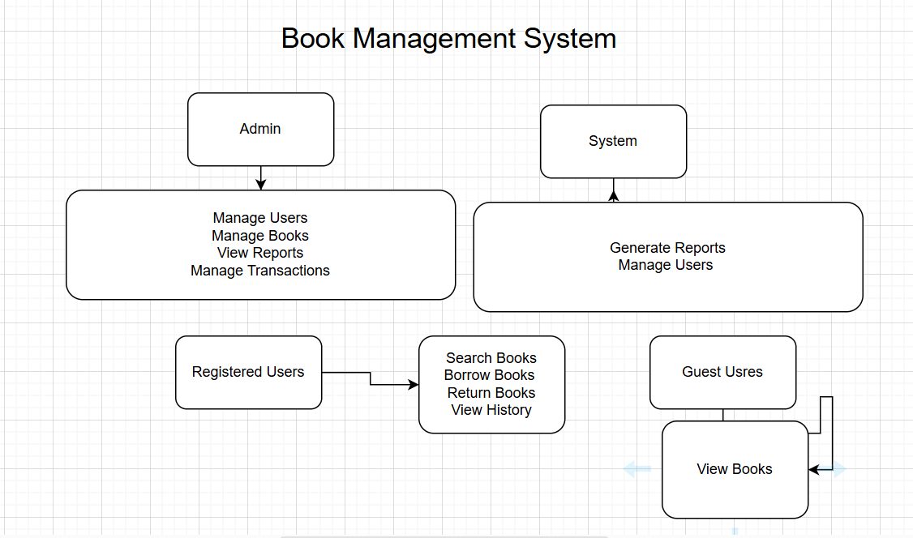
Sample USECASE Diagram

